Slide 1

Validate Configured Subscription YANG-Push Publisher Implementations NETCONF & NMOP WG
IETF 122
March 15-16th, 2025
Hackathon

Slide 2

Hackathon – Plan, Software and Website
Test Plan
Validate work in progress vendor YANG-Push publisher implementations.
Configure RFC 8641 compliant YANG-Push configured subscription.
Verify output in packet capture before YANG-Push receiver and after transformation.
Verify YANG Library and YANG-Push systems and notifications capabilities discovery.
Development Plan
MVP 1 – Basic Requirements (9)
MVP 2 – Scale and Secure (3)
MVP 3 – Optimizations (2)
Software
YANG-Push Publisher - Cisco IOS XR
YANG-Push Publisher - 6WIND VSR
YANG-Push Publisher - Huawei NE (Router) and MA (OLT)
YANG-Push Receiver – Pmacct
YANG-Push Receiver – Netgauze
udp-notif dissector - Wireshark
https://www.network-analytics.org/yp/how-to-deploy.html

Slide 3
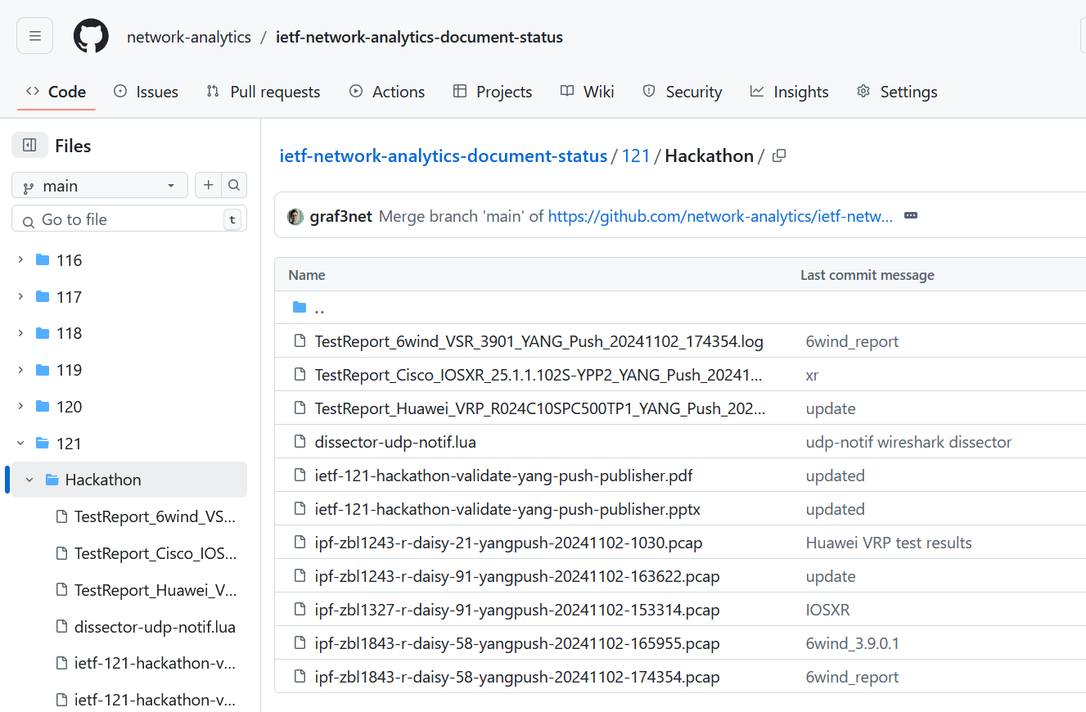
Hackathon – Repository
Test Repository
https://github.com/network-analytics/ietf-network-analytics-document-status/tree/main/122/Hackathon
Contains
Packet capture on the wire
Netconf RPCs and YANG-Push JSON and CBOR encoded messages
Python script which performed test cases

Slide 4
An Architecture for YANG-Push to Apache Kafka Integration draft-ietf-nmop-yang-kafka-integration
+------------------------------------------------------------+
| Time Series Database |
+------------------------------------------------------------+
^
| (12) Ingest Data
| According to Schema
+------------------------------------------------------------+
| Time Series Database Ingestion |
+------------------------------------------------------------+
(10) Get | ^ ^ (9) Validate
Schema | | | Serialized Message
| | | Schema on Consumer
| | |
| | +--------------------+
| | | Message |
| | | Broker |
| | +--------------------+
| | |
| | (11) Issue | (8) Serialize
| | | YANG-Push Message
| | | annotated Schema
v | Schema (6) Post | ID on Producer
+--------------------+ Schema +--------------------+
| YANG | <-------------- | Data Collection |
| Schema Registry | --------------> | YANG-Push Receiver |
+--------------------+ (7) Issue +--------------------+
Schema ID (4) Get | ^ (3) Receive
Schema | | YANG-Push
| | Subscription
| | Start Message
| | ^
| | |
| | | (5) Publish
| | | YANG-Push
| | | Message
| | | with
(1) Discover Notif. v | | Subscr. ID
+--------------------+ Capabilities +--------------------+
| Manage YANG-Push | ---------------> | Network Node |
| Subscription | (2) Subscribe | YANG-Push Publisher|
+--------------------+ ---------------> +--------------------+
Figure 1: End to End Workflow
Subscription to YANG Notifications RFC 8639
Subscription to YANG Notifications for Datastore Updates RFC 8641
UDP-based Transport for Configured Subscriptions draft-ietf-netconf-udp-notif
Subscription to Distributed Notifications draft-ietf-netconf-distributed-notif
Extensible YANG Model for YANG-Push Notifications draft-ietf-netconf-notif-envelope
Support of Versioning in YANG Notifications Subscription draft-ietf-netconf-yang-notifications-versioning
YANG Modules Describing Capabilities for Systems and Datastore Update Notifications RFC 9196
YANG Notification Transport Capabilities draft-ietf-netconf-yp-transport-capabilities
YANG Library RFC 8525
Augmented-by Addition into the IETF-YANG-Library draft-ietf-netconf-yang-library-augmentation
Encoding of Data Modeled with YANG in the CBOR RFC 9254

Slide 5

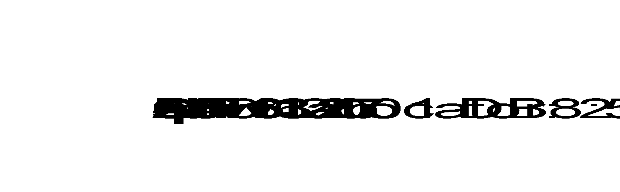

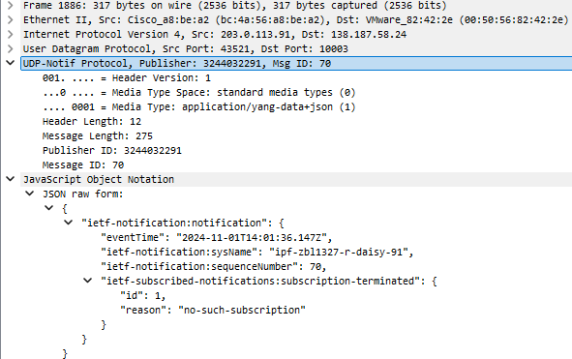
YANG-Push Data Processing Pipeline
Apache Kafka
{
"ietf-notification:notification": {
"eventTime": "2024-11-01T14:01:36.147Z",
"ietf-notification:sysName": "ipf-zbl1327-r-daisy-91",
"ietf-notification:sequenceNumber": 70,
"ietf-subscribed-notifications:subscription-terminated": {
"id": 1,
"reason": "no-such-subscription"
}
}
}
YANG-Push Publisher
YANG-Push Receiver
YANG Push JSON
Apache Kafka
JSON Message

Slide 6
Cisco IOS XR – Subscription Notifications
Subscription-Started Notification
{
"ietf-yp-notification:envelope": {
"event-time": "2025-03-12T11:33:37.918Z",
"hostname": "ios",
"sequence-number": 2,
"contents": {
"ietf-subscribed-notifications:subscription-started": {
"id": 0,
"ietf-yang-push:datastore": "operational",
"ietf-yang-push:datastore-xpath-filter": "Cisco-IOS-XR-pfi-im-cmd-oper:interfaces",
"transport": "ietf-udp-notif-transport:udp-notif",
"ietf-yang-push-revision:module-version": [
{
"module-name": "Cisco-IOS-XR-pfi-im-cmd-oper",
"revision": "2024-02-29"
}
],
"ietf-yang-push-revision:yang-library-content-id": "6da7f478e60adccd442070e18843ca1318b20ca4",
"encoding": "encode-json",
"ietf-yang-push:periodic": {
"period": 3000
}
}
}
}
}

Slide 7
Cisco IOS XR – YANG-Push Capabilities
Systems and Transport Capabilities
<?xml version="1.0"?>
<rpc-reply message-id="101" xmlns="urn:ietf:params:xml:ns:netconf:base:1.0">
<data>
<system-capabilities xmlns="urn:ietf:params:xml:ns:yang:ietf-system-capabilities">
<subscription-capabilities xmlns="urn:ietf:params:xml:ns:yang:ietf-notification-capabilities">
<max-nodes-per-update>4294967295</max-nodes-per-update>
<periodic-notifications-supported>state-changes</periodic-notifications-supported>
<minimum-update-period>3000</minimum-update-period>
<on-change-supported>state-changes</on-change-supported>
<notification-metadata xmlns="urn:ietf:params:xml:ns:yang:ietf-yp-notification">
<notification-envelope>true</notification-envelope>
<metadata>
<hostname-sequence-number>true</hostname-sequence-number>
</metadata>
</notification-metadata>
<transport-capabilities xmlns="urn:ietf:params:xml:ns:yang:ietf-notification-transport-capabilities">
<transport-capability>
<transport-protocol xmlns:idx="urn:ietf:params:xml:ns:yang:ietf-udp-notif-transport">idx:udp-notif </transport-protocol>
<encoding-format xmlns:idx="urn:ietf:params:xml:ns:yang:ietf-subscribed-notifications">idx:encode-json</encoding-format>
</transport-capability>
</transport-capabilities>
<yang-push-observation-supported xmlns="urn:ietf:params:xml:ns:yang:ietf-yp-observation">true</yang-push-observation-supported>
<yang-push-module-revision-supported xmlns="urn:ietf:params:xml:ns:yang:ietf-yang-push-revision">true</yang-push-module-revision-supported>
</subscription-capabilities>
</system-capabilities>
</data>
</rpc-reply>

Slide 8
Huawei MA – Push Notifications
Subscription Started Notification
{
"ietf-notification:notification": {
"eventTime": "2025-03-06T13:31:00.520+01:00",
"ietf-notification-sequencing:sysName": "ipd-zbl1535-s-fh-79",
"ietf-notification-sequencing:sequenceNumber": 0,
"ietf-subscribed-notifications:subscription-started": {
"id": 1,
"ietf-yang-push:datastore": "ietf-datastores:running",
"ietf-yang-push:datastore-xpath-filter": "/ietf-interfaces:interfaces-state/interface[type='iana-if-type:ethernetCsmacd']/statistics",
"dscp": 0,
"transport": "ietf-udp-notif-transport:udp-notif",
"encoding": "ietf-subscribed-notifications:encode-json",
"ietf-yang-push:periodic": {
"period": 500
}
}
}
}
Push-Update Notification of initial on-change sync-on-start
{
"ietf-notification:notification": {
"eventTime": "2025-03-06T13:31:00.970+01:00",
"ietf-notification-sequencing:sysName": "ipd-zbl1535-s-fh-79",
"ietf-notification-sequencing:sequenceNumber": 1,
"ietf-yang-push:push-update": {
"id": 20,
"ietf-yp-observation:timestamp": "2025-03-06T13:31:00.970+01:00",
"ietf-yp-observation:point-in-time": "initial-state",
"ietf-distributed-notif:message-publisher-id": 3021116856,
"datastore-contents": {
"ietf-interfaces:interfaces-state": {
"interface": [
{
"name": "ethernetCsmacd.0.9.0",
"oper-status": "up"
},
{
"name": "ethernetCsmacd.0.9.1",
"oper-status": "down"
},
{
"name": "ethernetCsmacd.0.9.2",
"oper-status": "down"
},

Slide 9
Huawei MA – YANG-Push Capabilities
System Capabilities
<?xml version="1.0" encoding="utf-8"?>
<rpc-reply message-id="1739882832263"
xmlns="urn:ietf:params:xml:ns:netconf:base:1.0">
<data>
<system-capabilities
xmlns="urn:ietf:params:xml:ns:yang:ietf-system-capabilities">
<datastore-capabilities
xmlns="urn:ietf:params:xml:ns:yang:ietf-system-capabilities">
<datastore
xmlns:ds="urn:ietf:params:xml:ns:yang:ietf-datastores">ds:running
</datastore>
<per-node-capabilities>
<node-selector
xmlns:if="urn:ietf:params:xml:ns:yang:ietf-interfaces"
xmlns:ianaift="urn:ietf:params:xml:ns:yang:iana-if-type">/if:interfaces-state/if:interface[if:type='ianaift:ethernetCsmacd']
</node-selector>
<subscription-capabilities
xmlns="urn:ietf:params:xml:ns:yang:ietf-notification-capabilities">
<max-nodes-per-update>2</max-nodes-per-update>
<on-change-supported>state-changes</on-change-supported>
<minimum-dampening-period>500</minimum-dampening-period>
<supported-excluded-change-type>none</supported-excluded-change-type>
</subscription-capabilities>
</per-node-capabilities>
</datastore-capabilities>
Subscription Capabilities
<subscription-capabilities
xmlns="urn:ietf:params:xml:ns:yang:ietf-notification-capabilities">
<max-nodes-per-update
xmlns="urn:ietf:params:xml:ns:yang:ietf-notification-capabilities">2
</max-nodes-per-update>
<periodic-notifications-supported
xmlns="urn:ietf:params:xml:ns:yang:ietf-notification-capabilities">config-changes state-changes
</periodic-notifications-supported>
<minimum-update-period
xmlns="urn:ietf:params:xml:ns:yang:ietf-notification-capabilities">6000
</minimum-update-period>
<on-change-supported
xmlns="urn:ietf:params:xml:ns:yang:ietf-notification-capabilities">state-changes
</on-change-supported>
<minimum-dampening-period
xmlns="urn:ietf:params:xml:ns:yang:ietf-notification-capabilities">1000
</minimum-dampening-period>
<supported-excluded-change-type
xmlns="urn:ietf:params:xml:ns:yang:ietf-notification-capabilities">none
</supported-excluded-change-type>
</subscription-capabilities>
</system-capabilities>
</data></rpc-reply>

Slide 10
6WIND VSR – Subscription Notifications
Subscription-Started Notification
{
"ietf-yp-notification:envelope": {
"event-time": "2025-03-04T07:31:36.806021107+00:00",
"hostname": "daisy-ietf-ipf-zbl1843-r-daisy-58",
"sequence-number": 48,
"notification-contents": {
"ietf-subscribed-notifications:subscription-started": {
"id": 12345678,
"ietf-yang-push:datastore": "ietf-datastores:operational",
"ietf-yang-push:datastore-xpath-filter": "/state/vrf/l3vrf/interface/loopback/enabled",
"transport": "ietf-udp-notif-transport:udp-notif",
"encoding": "encode-json",
"purpose": "send notifications",
"ietf-distributed-notif:message-publisher-ids": [
0
],
"ietf-yang-push:on-change": {
"sync-on-start": true
},
"ietf-yang-push-revision:module-version": [
{
"module-name": "vrouter-loopback",
"revision": "2024-04-22"
}
],
"ietf-yang-push-revision:yang-library-content-id": "3625735881"
}
}
}
}

Slide 11
6WIND VSR – Push Notifications
Push-Update Notification
{
"ietf-yp-notification:envelope": {
"event-time": "2025-03-04T07:37:40.725023242+00:00",
"hostname": "daisy-ietf-ipf-zbl1843-r-daisy-58",
"sequence-number": 58,
"notification-contents": {
"ietf-yang-push:push-update": {
"id": 4,
"datastore-contents": {
"vrouter:state": {
"vrf": [
{
"name": "main",
"vrouter-interface:interface": {
"physical": [
{
"name": "ens192",
"counters": {
"in-octets": "189227",
"in-unicast-pkts": "736",
"in-discards": "271",
"in-errors": "0",
"out-octets": "759448",
"out-unicast-pkts": "5548",
"out-discards": "0",
"out-errors": "0"
Push-Change-Update Notification
{
"ietf-yp-notification:envelope": {
"event-time": "2025-03-04T07:32:37.561586599+00:00",
"hostname": "daisy-ietf-ipf-zbl1843-r-daisy-58",
"sequence-number": 50,
"notification-contents": {
"ietf-yang-push:push-change-update": {
"id": 3,
"datastore-changes": {
"yang-patch": {
"patch-id": "patch-1",
"edit": [
{
"edit-id": "edit-1",
"operation": "replace",
"target": "/vrouter:state/vrf[name='main']/l3vrf[name='A9']/vrouter-interface:interface/vrouter-loopback:loopback[name='Loopback-A9']/enabled",
"value": {
"vrouter-loopback:enabled": "false"
}
}
]
}
},
"ietf-distributed-notif:message-publisher-id": 0,
"ietf-yp-observation:timestamp": "2025-03-04T07:32:37.561829359+00:00",
"ietf-yp-observation:point-in-time": "state-changed"
}
}
}
}

Slide 12
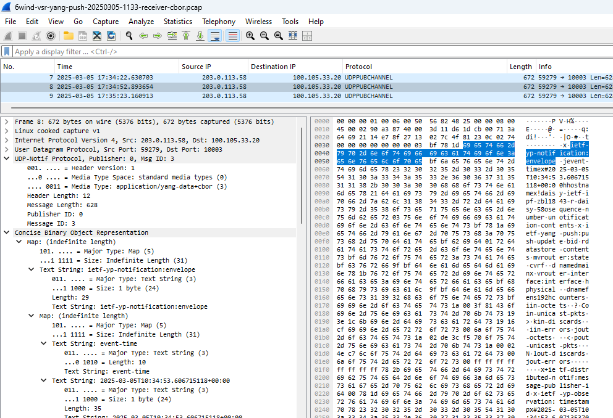
6WIND VSR – CBOR Named Identifiers

Slide 13

YANG-Push Implementation Status IETF 122 – MVP 1
 | 6WIND VSR | Huawei NE | Huawei MA | Cisco IOS XR | Open-Source
RFC 8639 YANG-Push Subscription | ✔ | ✔ | ✔ | ✔
RFC 8641 YANG-Push Notification | ✔ | ✔ | ✔ | ✔
draft-ietf-netconf-udp-notif | ✔ | ✔ | ✔ | ✔ | ✔
draft-ietf-netconf-yang-notifications-versioning | ✔ | ✔ | ✔ | ✔
draft-tgraf-netconf-notif-sequencing | ✔ | ✔ | ✔ | ✔
draft-tgraf-netconf-yang-push-observation-time | ✔ | ✔ | ✔ | ✔
RFC 8525 YANG Library | ✔ | ✔ | ✔ | ✔
draft-ietf-netconf-yang-library-augmentation | ✔ | ✔ | ✔ |  | ✔
RFC 9196 System and Notification Capabilities |  |  | ✔
draft-netana-netconf-notif-envelope | ✔ |  |  | ✔
Green marked describes new capability at IETF 122. "P" to partially implemented.

Slide 14
YANG-Push Implementation Status IETF 122 – MVP 2
 | 6WIND VSR | Huawei NE | Huawei MA | Cisco IOS XR | Open-Source
draft-ietf-netconf-distributed-notif | ✔ | ✔ | ✔
RFC 9254 CBOR Named Identifiers | ✔
RFC 6347/RFC 9147 DTLS
Green marked describes new capability at IETF 122. "P" to partially implemented

Slide 15
YANG-Push Implementation Status IETF 122 – MVP 3
 | 6WIND VSR | Huawei NE | Huawei MA | Cisco IOS XR | Open-Source
RFC 8641 on-change subscriptions | ✔ | ✔ | ✔ | P
draft-netana-netconf-yp-transport-capabilities |  |  | ✔ | ✔
Green marked describes new capability at IETF 122. "P" to partially implemented

Slide 16
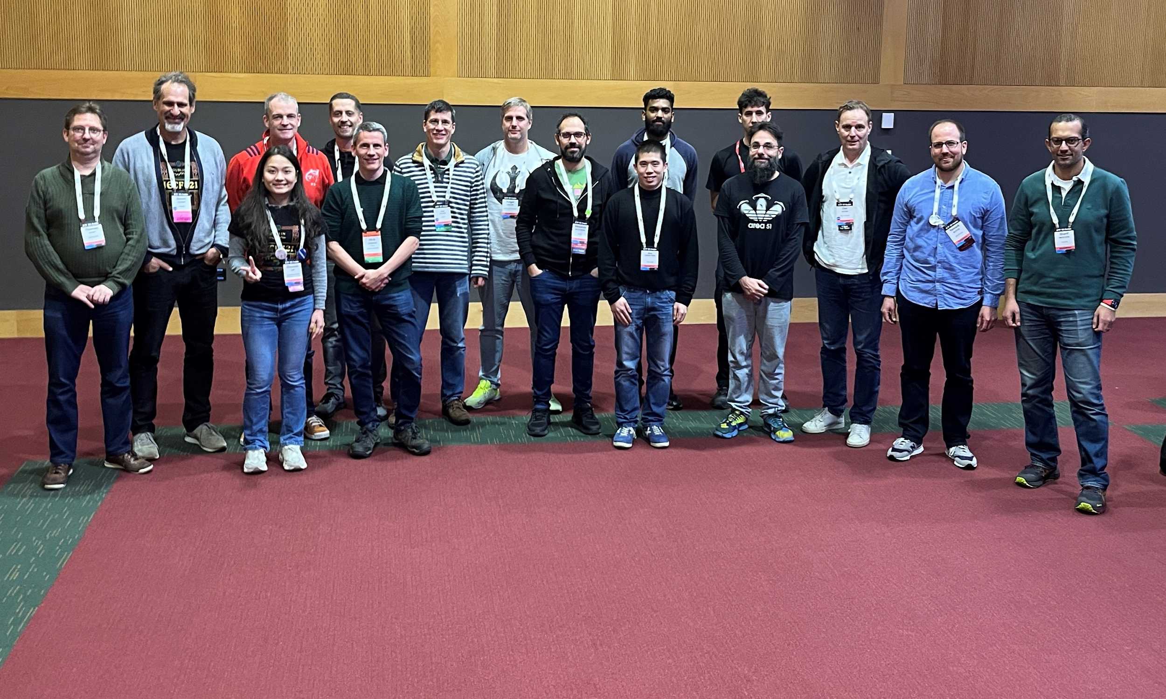
Thanks to…
Rob Wilton – Cisco
Nick Corran – Cisco (remote)
Emma Rankin – Cisco (remote)
Mathew Green – Cisco (remote)
Samuel Gauthier – 6WIND (remote)
Jérémie Leska – 6WIND (remote)
Liu Bin – Huawei (remote)
Benoit Claise – Huawei
Zhuoyao Lin – Huawei (remote)
Jiale Li – Huawei (remote)
Jian Ping– Huawei (remote)
Xiao Chen– Huawei (remote)
Paolo Lucente – Pmacct
Holger Keller – DT
Nils Warnke - DT
Alex Huang-Feng – INSA Lyon
Yannick Buchs – Swisscom (remote)
Thomas Graf – Swisscom

